Slide 1

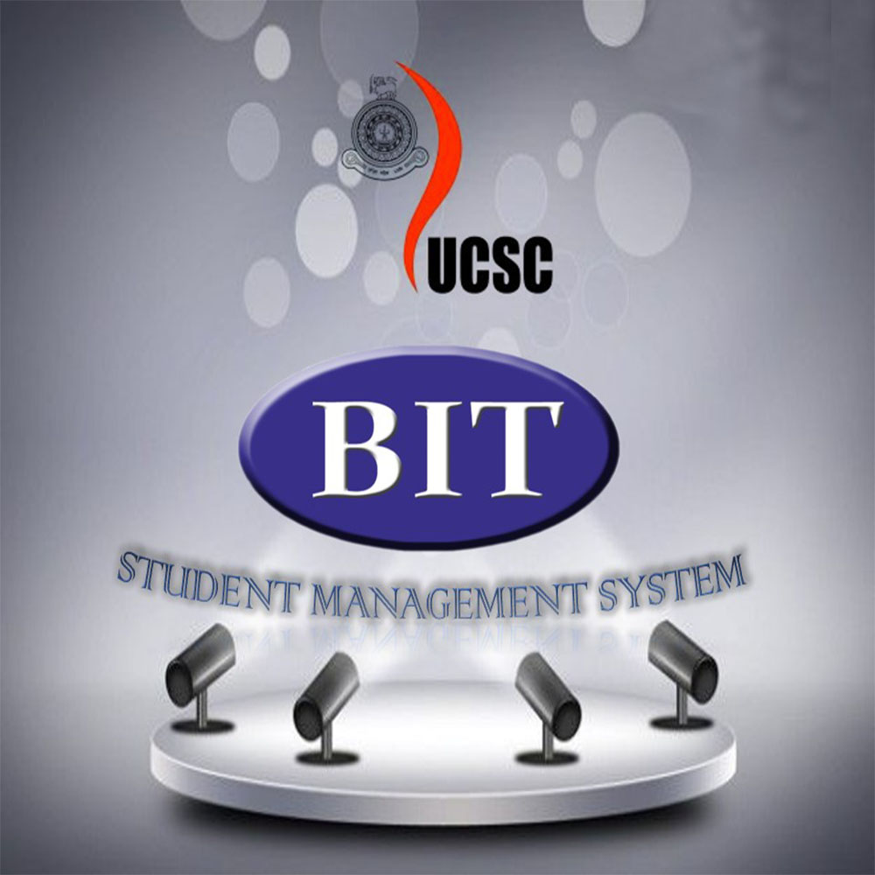
Group 14
Interim Presentation
IS 3013/SCS 3117
Date – 19.05.2016

Slide 2
Overview of the presentation
Introduction, Goals and Objectives
Evidence of requirements and data gathering
System Analysis
System Design and Architecture
Implementation Plan

Slide 3
Introduction
Student Management System, developed to External Degree Center (EDC), University of Colombo School of Computing.
In order to achieve efficiency and effectiveness of the EDC processes. Which can be divided in,
1) Registration Process
2) Examination Preparation Process

Slide 4
Goals & Objectives
Our main Goal is to,
Minimize the complications of handling student management process in order to have an effective and efficient management system.
Objectives
Automate the student selection process.
Automate the process of calling the candidates for the registration.
Automate the examination process.
Increase the consistency of data entry through a standardized format.
Improve the communication between the BIT center and students by providing accessibility to both parties.

Slide 5
Requirement Gathering Techniques
User Interviews -:
Client meeting are undertaken to clarify the what the user is really required from the developed system.
Develop “user stories” to identify required functionalities of each user.
Examine the similar systems
Ugvle, Science Student Management System.
Prototyping -:
Quickly identified functionalities that had been missed in previous sessions.
excellent way to present ideas and nurture communication, can highlight overlooked areas.

Slide 6
Functional Requirements
Student Registration Process
Calling Applications for Registration
Enter payment details
Filter the applications and call for interviews
Selection and Registration of Students
Generate Student IDs

Slide 7
Functional Requirements
Examination Process
Call applications for exams
Enter payment details
Publish the schedule for the examinations
Generate admission cards for exam
Allocation of students and staff for the exam centers
Generate reports for exam enters (attendance sheets, summary sheets, etc.)
Publish the finalized results

Slide 8
Non- Functional Requirements
Reliable
The system is included with the rollback features.
Availability
The system is deployed in a UCSC server and the availability of the system depends on the availability of the server.
Security
As the system is designed with java most of the security issues are overcome automatically.

Slide 9
Non- Functional Requirements
Maintainability
Modularity of java helps a lot in maintainability process
User friendliness
User friendliness is one of major attribute that a web based should have in order to be more understandable to the user.

Slide 10
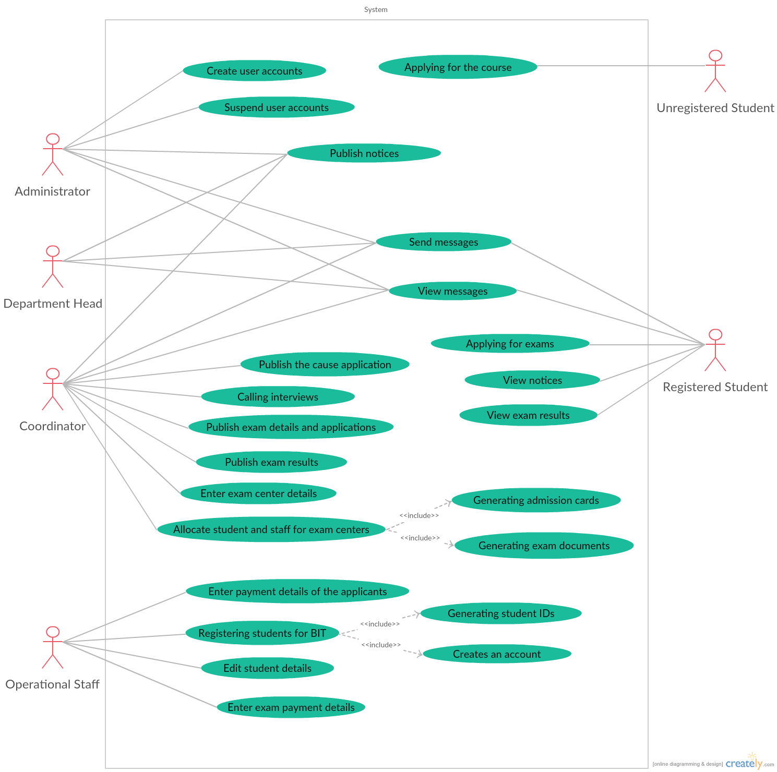
Use Case Diagram

Slide 11
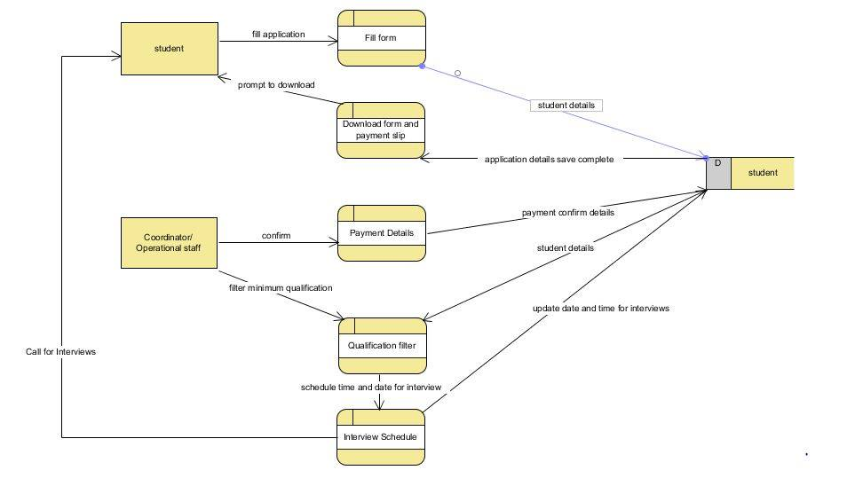
Data Flow Diagram

Slide 12
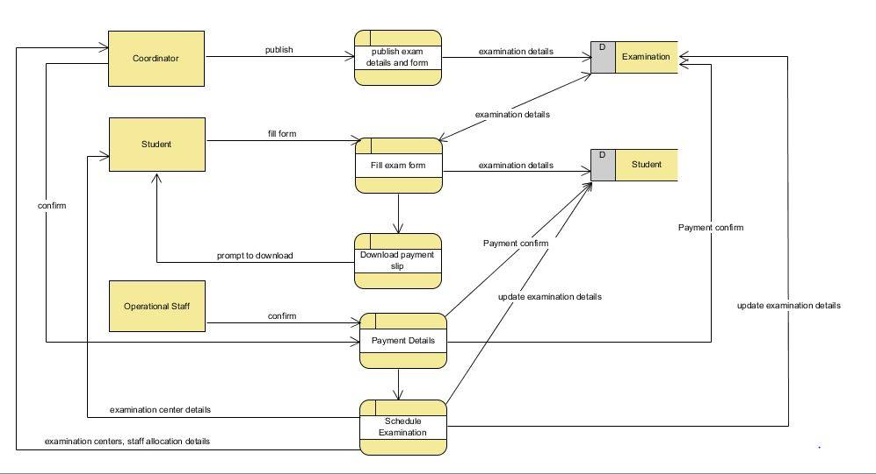
Data Flow Diagram

Slide 13
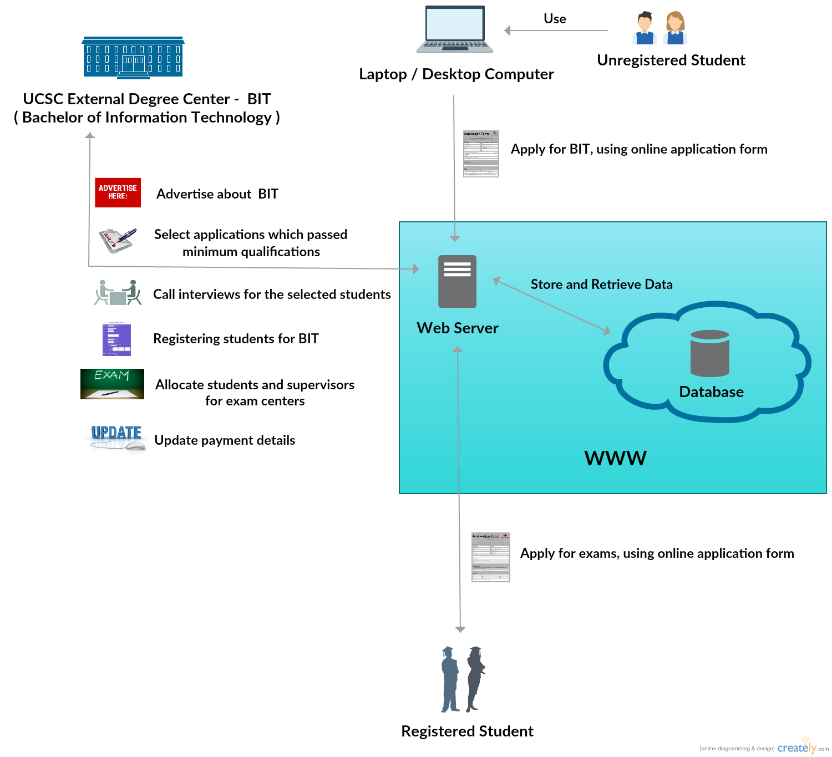
System Architecture

Slide 14
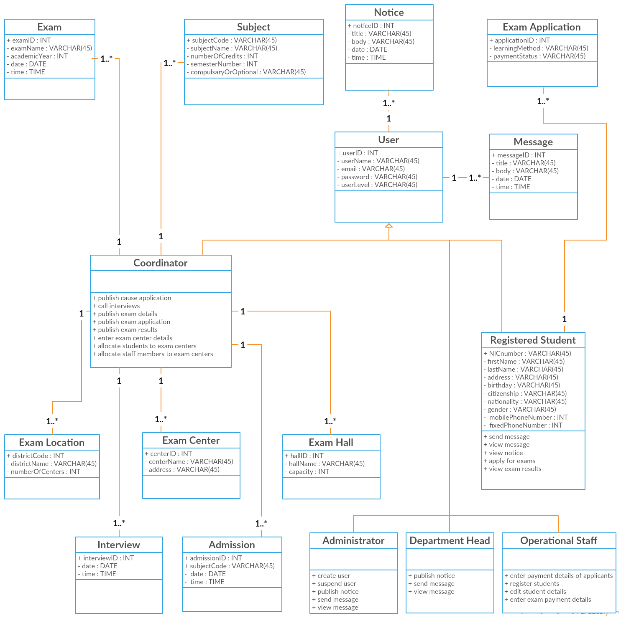
Class Diagram

Slide 15
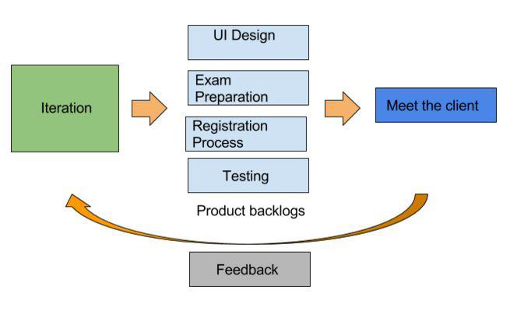
Implementation Plan

Slide 16
Implementation Plan
Agile practices are followed, Divided into 3 iterations.
Whole the functionalities will be divided 3 product backlogs, then development carried out in each iteration.
Each backlogs will be developed
simultaneously.

Slide 17


Slide 18


